Slide 1
Don’t get phished!, recognize the bait
Phil Kraemer

Slide 2
Overview
What is Phishing?
Types of Phishing Attacks
Additional Resources
Phishing Examples
Phishing Test
Protect Yourself from Phishing

Slide 3
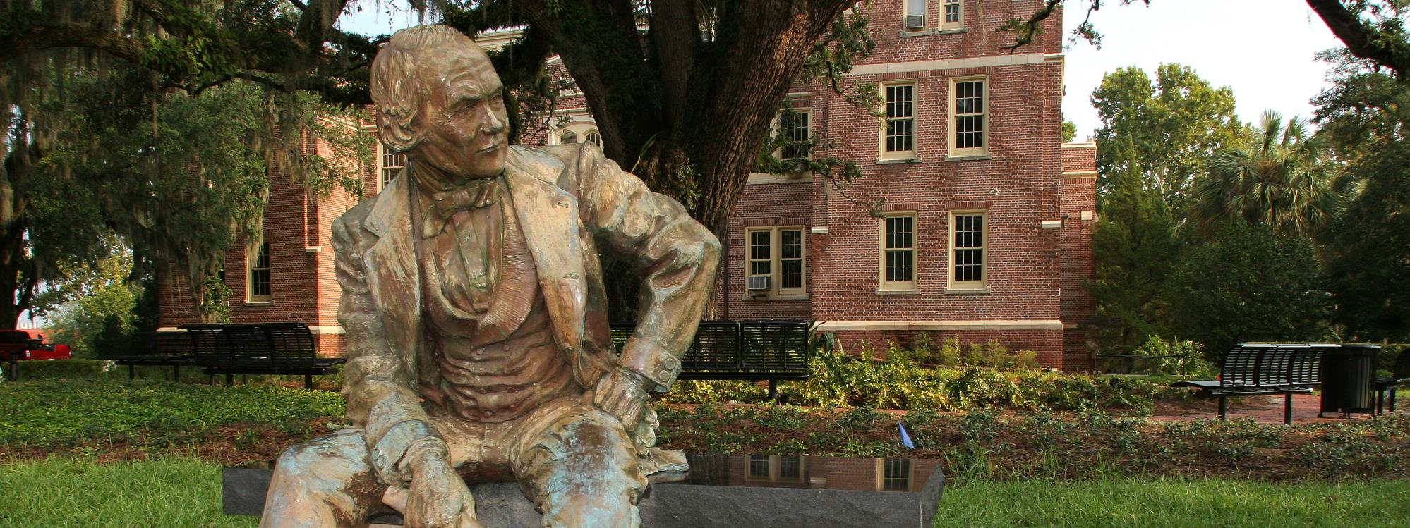
What is Phishing?
Definition of phishing

Slide 4
What is Phishing?
Phishing emails, websites and phone calls are designed to steal sensitive information. Cybercriminals can do this by installing malicious software on your computer, tricking you into giving them personal information or outright stealing personal information off your computer.

Slide 5
Types of phishing attacks
Overview of various methods of phishing

Slide 6
Types of phishing attacks
Social Engineering
/ˈsōSHəl ˌenjəˈni(ə)riNG/ n. using deception to manipulate someone into giving up personal information that may be used for fraudulent purposes
On your Facebook profile you can find:
Name
Date of birth
Location
Workplace
Hobbies
Relationship status
Email address
Favorite food …
Everything a cybercriminal needs to fool you into thinking that the message or email is legitimate and coming from someone you know.

Slide 7
Types of phishing attacks
Spear Phishing
/spir fiSHiNG/ n. sending fraudulent emails from a known or trusted sender in order to trick targeted individuals into giving up confidential information
Attackers may gather personal information (social engineering) about their targets to increase their probability of success
Fast fact
Accounts for 91% of phishing attacks
Most successful form of phishing on the internet today

Slide 8
Types of phishing attacks
Clone Phishing
/klōn fiSHiNG/ n. replicating a legitimate, previously delivered email and replacing the attachment or link with a malicious version
Tricky, tricky
Sent to the same recipient addresses as the original message
Sent from an email address spoofed to appear as though it’s coming from the original sender

Slide 9
Types of phishing attacks
Voice Phishing
/vois fiSHiNG/ n. using social engineering over the phone to gain access to personal and financial information
AKA: Vishing
Typically used to steal credit card numbers or other information used in identity theft schemes
Phrases to watch for
You've been specially selected for XYZ.
You'll get a free bonus if you buy our product.
You have to make up your mind right away.
We'll put the shipping charges on your credit card.
You trust me, right?

Slide 10
Types of phishing attacks
Link Manipulation
/liNGk məˌnipyəˈlāSHən/ n. phishing strategy in which a spoofed email link appears to belong to a legitimate organization or person
Watch for:
Misspelled URLs
Subdomains
Tip
Hover over or long tap a link to display the true URL and see if it’s linking to a reputable website
Email clients or web browsers show previews of links in the bottom left of the screen

Slide 11
Phishing examples
Examples of real phishing attacks

Slide 12
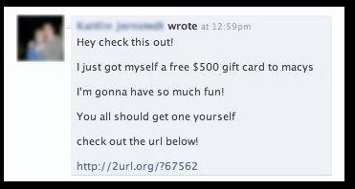
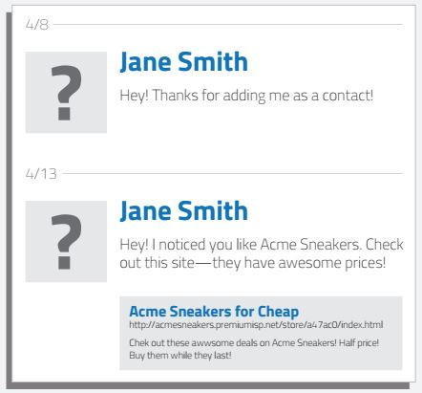
Phishing Examples – Social Engineering
Cybercriminals scan social media profiles for your interests, then send you a targeted message trying to get you to click a link
Upon clicking the link, you would be prompted to sign in to a fake sign in page that would steal your username and password
Then the cybercriminal takes over your profile and sends another phishing attack to your friends and contacts

Slide 13
Phishing Examples – Spear Phishing
Watch out for these tricks
Sent from someone you don’t know or from whom you weren’t expending an email
Subjects are in all caps or have lots of !!!!! to make you think the message is important and urgent
When you hover over the link, you see it is taking you to an unknown site

Slide 14
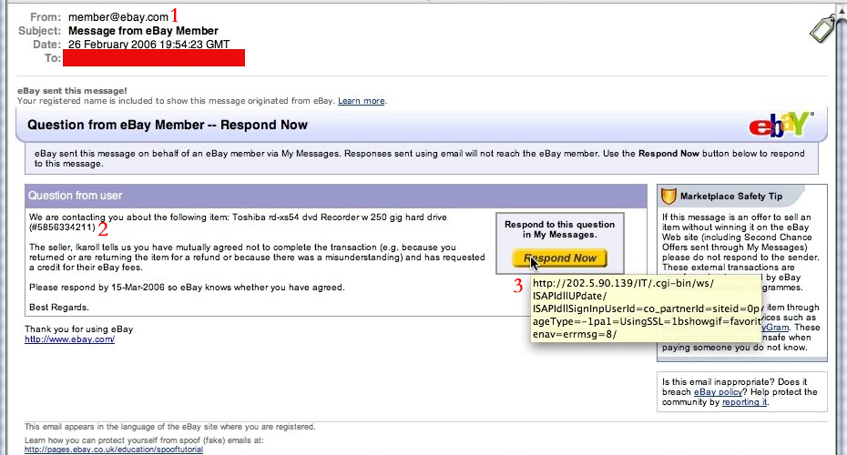
Phishing Examples – Clone Phishing
These emails are harder to spot because they look like legitimate emails you would normally receive.
Watch out for these tricks
Sent from a generic address
Regarding a product you did not purchase
When you hover over the link, you see it is taking you to an unknown or unexpected site

Slide 15
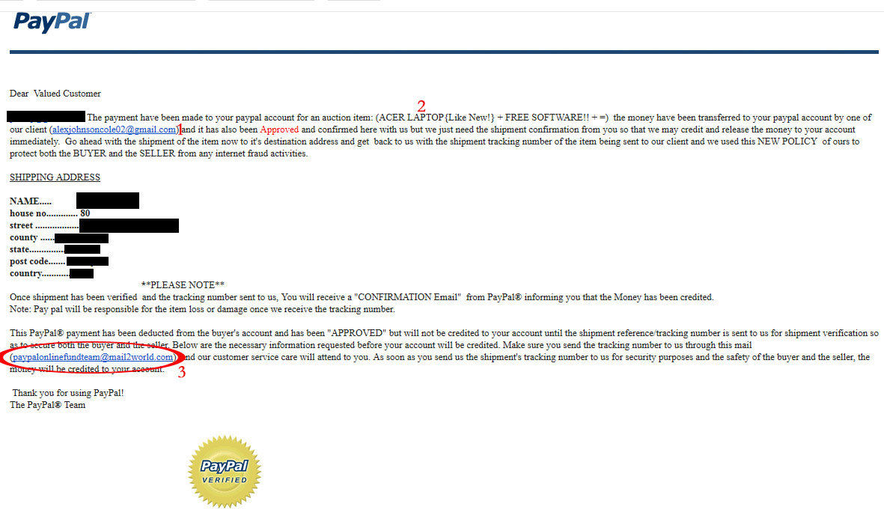
Phishing Examples – Clone Phishing
Again, the email looks like an official company message.
Watch out for these tricks
Do you recognize the sender?
Did you purchase this product?
Does the link or email point to a reputable site or person? (Example: If this was an official email from PayPal, it would end in “@paypal.com”)

Slide 16
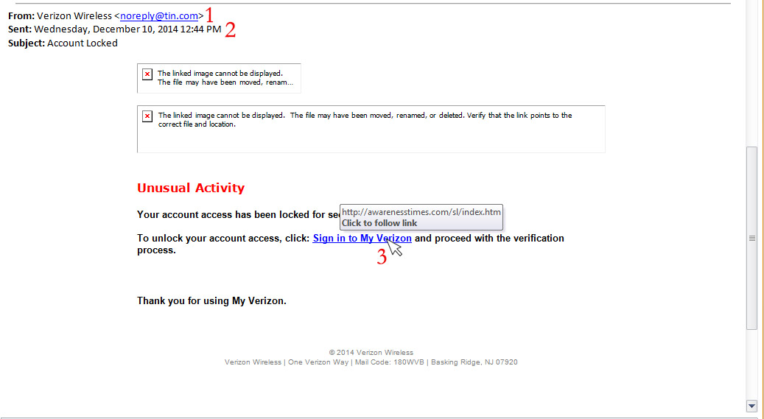
Phishing Examples – Link Manipulation
Warning signs
Not an official Verizon email address
“To” field missing
Link is pointing to a strange and unfamiliar website

Slide 17
Phishing test
Can you spot the tell-tale signs of a phishing email?

Slide 18
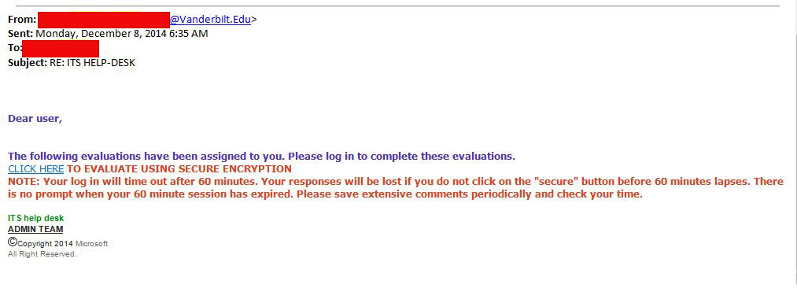
Phishing Test
Can you spot the tell-tale signs of a phishing email?
Email is not a valid fsu.edu address
The “To” and “Cc” fields are missing
Link is pointing to an odd, non-FSU site

Slide 19
protect yourself from phishing
Tips to protect yourself from phishing attacks

Slide 20
Tips to protect yourself from phishing
FSU will
NEVER
ask for your password over email

Slide 21
Tips to protect yourself from phishing
Be wary of emails asking for passwords
Never send passwords, bank account numbers or other private information in an email
Be cautious about opening attachments and downloading files from emails, regardless of who sent them
If you are not expecting an attachment from someone, call and ask them if they sent the email
Never enter private or personal information into a popup window
Hover over or long tap links in emails to display the true URL and see if it is linking to a reputable website
Look for https:// and a lock icon in the website address bar before entering any private information on a website
Watch for spelling and grammar mistakes

Slide 22
Tips to protect yourself from vishing
Don’t buy from unfamiliar companies
Check out companies with the Better Business Bureau, National Fraud Information Center or other watchdog groups
Verify a salesperson’s name, business identity, phone number, street address, mailing address and business license number before you transact business
Don’t pay for a “free prize.” If a caller tells you the payment is for taxes, he is violating federal law.
Never give out personal information such as credit card numbers and expiration dates, bank account numbers, dates of birth or SSNs to unfamiliar companies
If you have been victimized once, be wary of calls offering to help you recover your losses for a fee paid in advance

Slide 23
Have I been pwned?
Has my email address been compromised?
https://haveibeenpwned.com

Slide 24
What to do when you’ve been phished
Email
DO NOT click any links or open any attachments in the email
Forward the email to abuse@fsu.edu
Check the phish bowl at security.fsu.edu/phish-bowl
Phone call
Look up the phone number on Google or the following sites to see if the call is a scam
800notes.com
callercenter.com
callercomplaints.com
Report any caller who is rude, abusive or questionable
877-FTC-HELP
ftc.gov/complaint

Slide 25
How is FSU protecting you?
Multi-step verification
Phish bowl
abuse@fsu.edu
Twitter - @fsu_cybersec
Training and outreach – call us to come to your organization

Slide 26
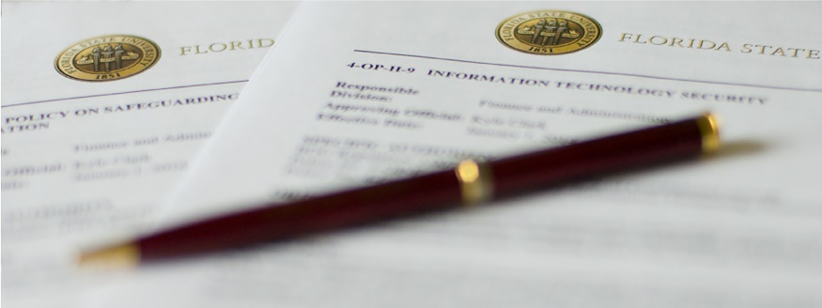
Additional resources
More phishing online resources

Slide 27
Additional resources
http://security.fsu.edu
http://www.antiphishing.org/
http://www.fraudwatchinternational.com/phishing-alerts
http://phishme.com/
http://www.onguardonline.gov/phishing
http://www.consumer.ftc.gov/articles/0076-phone-scams
http://www.fbi.gov/scams-safety/fraud

Slide 28
Questions?

Slide 29
Contact
Philip Kraemer
ISPO SecurityTraining Coordinator
Information Technology Services
Florida State University
pkraemer@fsu.edu
(850) 645-3600

